Slide 1
Which beach in Chicago is best for the family?

Slide 2


Slide 3
Beach_E_coli_Predictions.csv
Beach_Swim_Advisories.csv
Beach_Water_Quality.csv
Beach_Weather_Stations.csv

Slide 4
Data analysis of the following:
Turbidity
Wave Height
Temperature
E. Coli

Slide 5
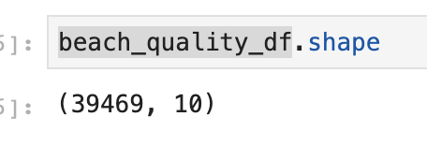
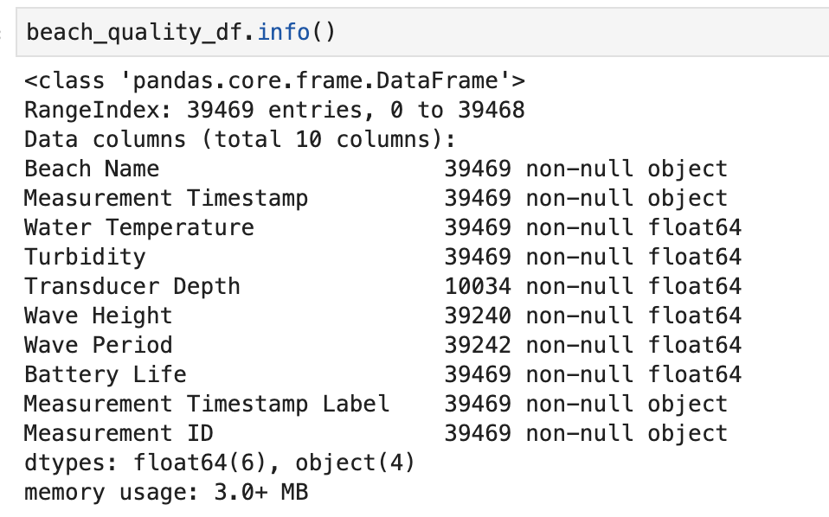

Slide 6
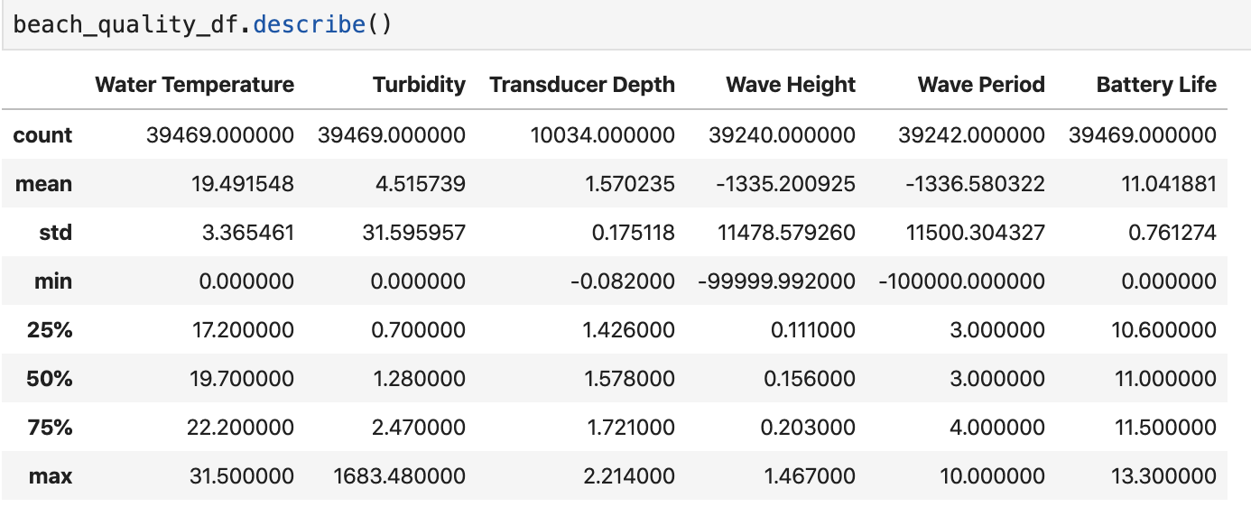

Slide 7
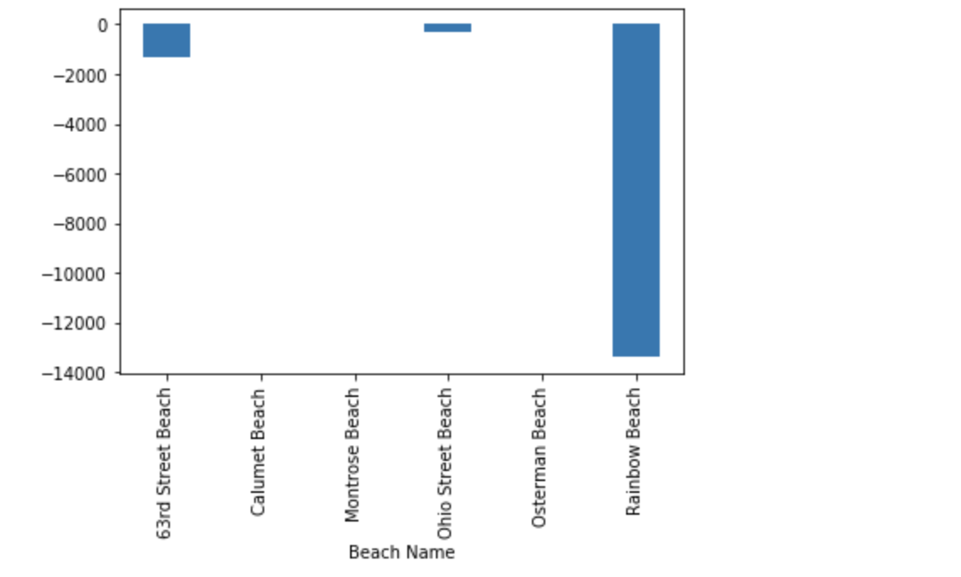

Slide 8
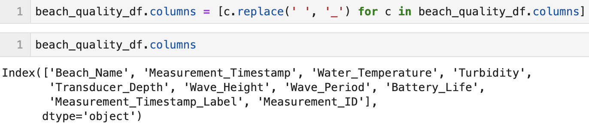

Slide 9
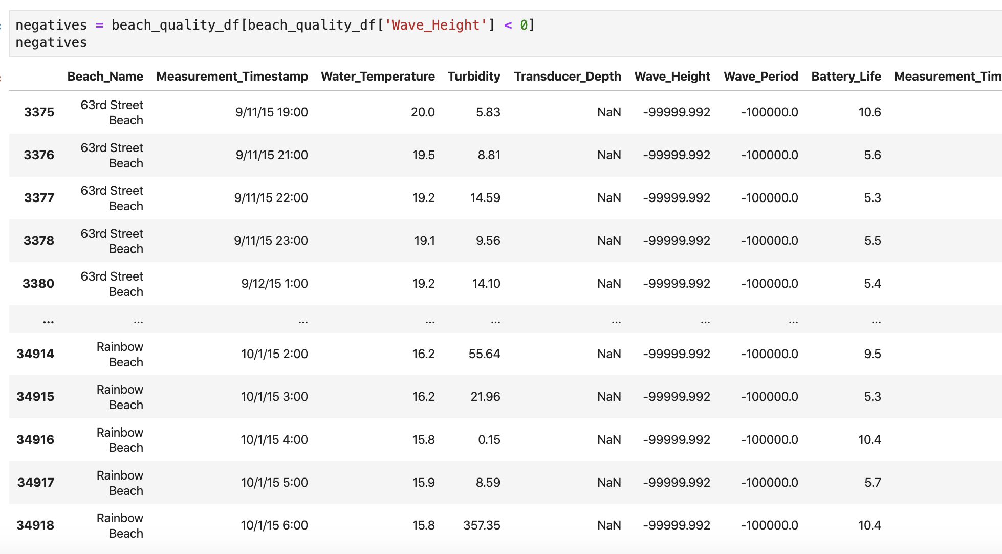

Slide 10
Which beach has the most E. Coli?

Slide 11
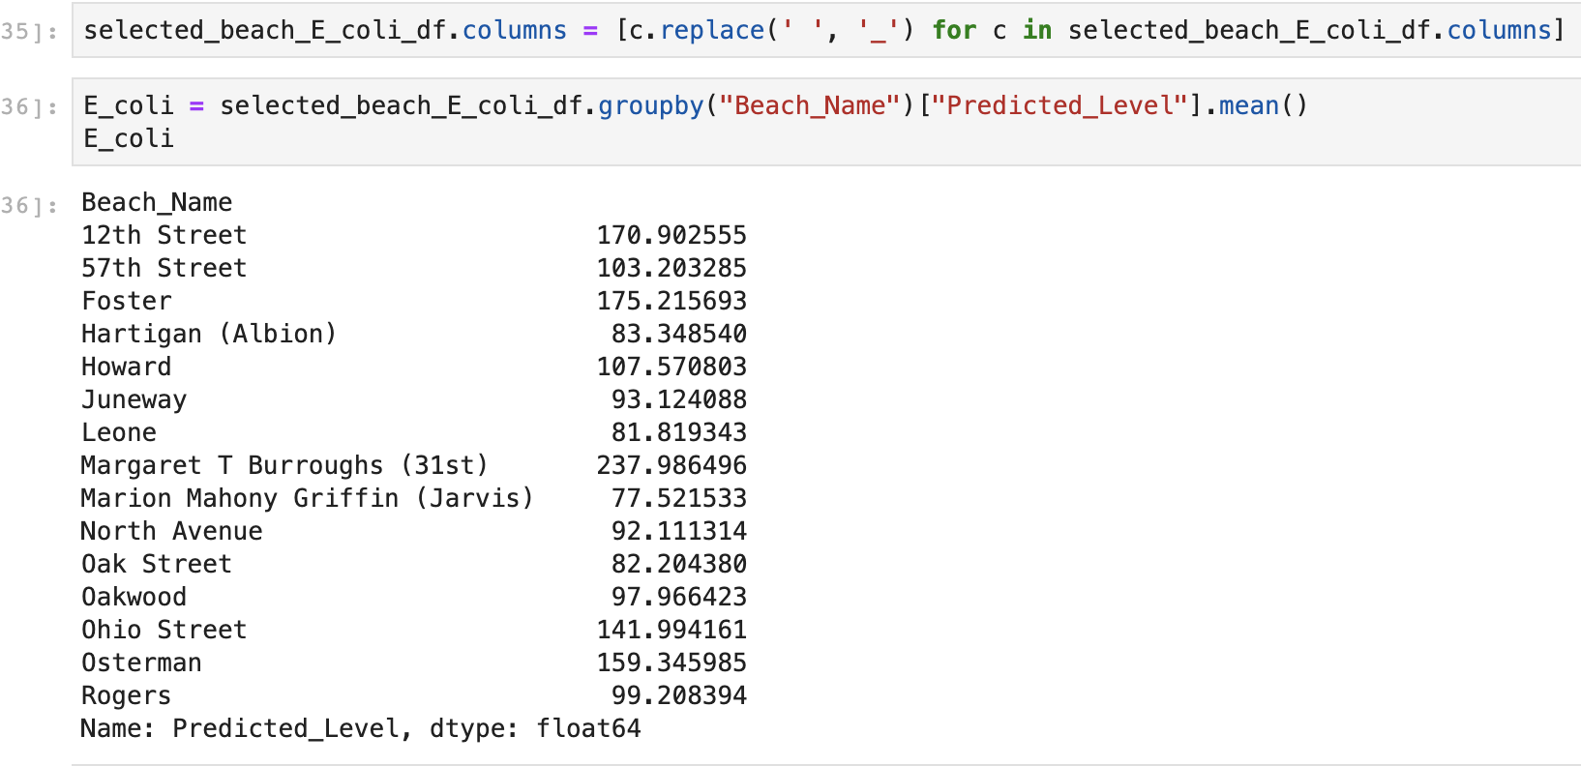

Slide 12
